Slide 1
Do not delete this slide.
This slide is designed so that you can copy the prompt box you need and insert it into your slides.
This slide is hidden and will not be included when presenting your lesson.
TRACK WITH ME
VOCABULARY
1 -
HINT
Students, remember….
CHECK FOR UNDERSTANDING
READ WITH ME
TEACHER CUE
MAKE THE CONNECTION
Students, you already know….
EXTENSION
GESTURE WITH ME

Slide 2
Punnet Square Review
This gene has a dominant allele for brown eyes (B) and a recessive allele for blue eyes (b).
Rachel and James are having a baby and are wondering what the chances are that it will have blue eyes. Both Rachel and James are heterozygous for eye colour. Determine Rachel and James' genotypes and construct a Punnett square. Then calculate the percent probability that their child will have blue eyes.
Rachel's genotype: James' genotype:
Percent probability the baby's eyes will be blue:

Slide 3
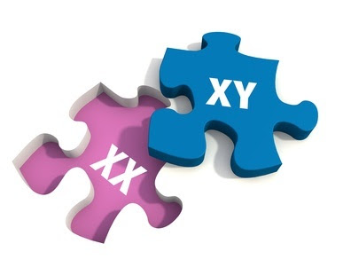
Sex-Linked Traits
We will predict the outcome of sex-linked trait inheritance using Punnett squares
Notes:
Insert cover image and use transparency settings to fade image.

Slide 4
We will predict the outcome of sex-linked trait inheritance using Punnett squares
TRACK WITH ME
READ WITH ME
Use the correct notation for a sex-linked allele.
Construct a Punnett square using sex-linked alleles.
Use a Punnett square to determine the probability that a couple's child have a particular phenotype.
Notes:
Learning Objectives contain concepts (nouns, big ideas), skills (verbs, measurable behaviours) and sometimes context (restricting or targeting conditions).
●Example: Students will be able to describe the concept of density and apply it to floating and sinking.
●
Success criteria are specific measurable outcomes that if met mean that the student has met the learning objective.
Examples:
•Students will be able to compare densities of substances using mass and volume.
•Students will be able to identify whether a solid or liquid will float or sink in a liquid based on their densities.

Slide 5
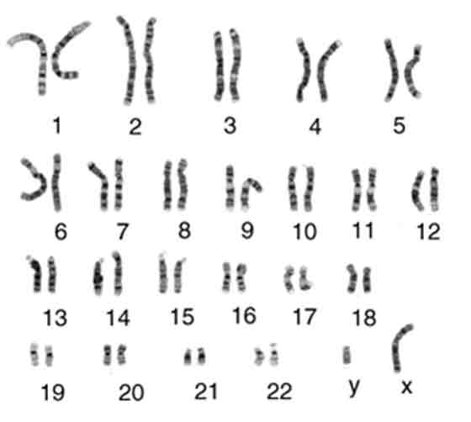
We will predict the outcome of sex-linked trait inheritance using Punnett squares
TEACHER CUE
Which chromosome pair do you think is related to the sex of an individual, why?
Humans have 23 pairs of chromosomes.
One pair of chromosomes is related to the sex of an individual, these chromosomes are called sex chromosomes

Slide 6
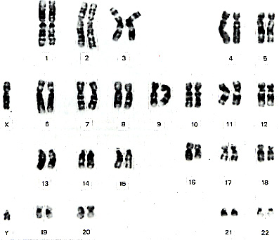
We will predict the outcome of sex-linked trait inheritance using Punnett squares
The other 22 pairs of chromosomes are called autosomes (1-22).

Slide 7
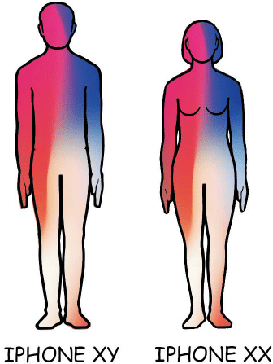
We will predict the outcome of sex-linked trait inheritance using Punnett squares
In humans, the sex of an individual depends on the presence or absence of the Y chromosome.
A normal human female is XX
A normal human male is XY

Slide 8
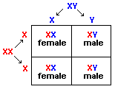
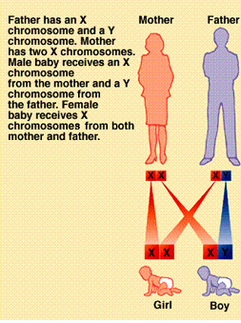
We will predict the outcome of sex-linked trait inheritance using Punnett squares
TEACHER CUE
Class Answers

Slide 9
We will predict the outcome of sex-linked trait inheritance using Punnett squares
Genes that are located on the X chromosome are called sex-linked genes. (They are not carried on the Y chromosome)
Traits determined by sex-linked genes are called sex-linked traits
(b = colorblind, B = normal)
Eg. Colour blindness in males and females
female X^{b} X^{b}
male X^{b} Y
MAKE THE CONNECTION
Students, you already know about dominant and recessive, who is at greater risk of negative sex-linked traits: males or females Why?

Slide 10
CHECK FOR UNDERSTANDING
I DO
We will predict the outcome of sex-linked trait inheritance using Punnett squares
A colourblind male marries a normal female. What are the offspring genotypes and phenotypes? (B = normal, b = colourblind)
X Y
X
X
STEPS 1. Place the parents alongside the top and the left of the table
2. Add in the sex-linked subscripts (only on the X’s!)
2. ‘Multiply’ the letters to complete the table
3. Genotypes = codes
4. Phenotypes = physical appearance

Slide 11
CHECK FOR UNDERSTANDING
WE DO
We will predict the outcome of sex-linked trait inheritance using Punnett squares
A normal male (not colourblind) marries a carrier. What are the offspring genotypes and phenotypes? (B = normal, b = colourblind)
X Y
X
X
STEPS 1. Place the parents alongside the top and the left of the table
2. Add in the sex-linked subscripts (only on the X’s!)
2. ‘Multiply’ the letters to complete the table
3. Genotypes = codes
4. Phenotypes = physical appearance

Slide 12
CHECK FOR UNDERSTANDING
YOU DO
We will predict the outcome of sex-linked trait inheritance using Punnett squares
A normal male (not colourblind) marries a colourblind female. What are the offspring genotypes and phenotypes? (B = normal, b = colourblind)
X Y
X
X
STEPS 1. Place the parents alongside the top and the left of the table
2. Add in the sex-linked subscripts (only on the X’s!)
2. ‘Multiply’ the letters to complete the table
3. Genotypes = codes
4. Phenotypes = physical appearance

Slide 13


Your number is important to me!
Rapid 5
Exit Ticket

Slide 14
We will predict the outcome of sex-linked trait inheritance using Punnett squares
TRACK WITH ME
READ WITH ME
Use the correct notation for a sex-linked allele.
Construct a Punnett square using sex-linked alleles.
Use a Punnett square to determine the probability that a couple's child have a particular phenotype.
Notes:
Learning Objectives contain concepts (nouns, big ideas), skills (verbs, measurable behaviours) and sometimes context (restricting or targeting conditions).
●Example: Students will be able to describe the concept of density and apply it to floating and sinking.
●
Success criteria are specific measurable outcomes that if met mean that the student has met the learning objective.
Examples:
•Students will be able to compare densities of substances using mass and volume.
•Students will be able to identify whether a solid or liquid will float or sink in a liquid based on their densities.

